Slide 1
Senior Project: Distributed File System (Nebula)
Trung Nguyen

Slide 2
3. Abstract
This project involves the design and implementation of a distributed file system, a system for managing and accessing large data files across multiple networked nodes. Our focus is on providing high scalability, fault tolerance, and seamless data access. Leveraging replication, load balancing, and data partitioning, the system aims to ensure efficient storage utilization and quick data retrieval, even under high traffic. Key components include metadata management, data consistency protocols, and secure access controls

Slide 3
Project Goal
Scalability
Fault Tolerance
Efficient Access
Consistency
Security

Slide 4
2. Names
Member: Trung Nguyen (nguye6tq@mail.uc.edu)
Advisor: TBD

Slide 5
4. User Stories
As a software engineer, I want to read/write file from the storage system efficiently so that it can reduce latency and improve the performance of my application.
As a data engineer, I want to store large datasets across multiple storage nodes so that I can ensure data reliability and high availability.
As a security engineer, I want to maintain data integrity across distributed storage nodes so that I can ensure files are not corrupted or tampered with during storage or transfer

Slide 6
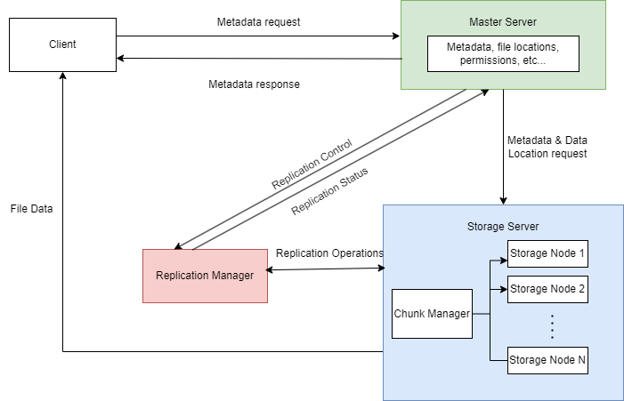

Slide 7
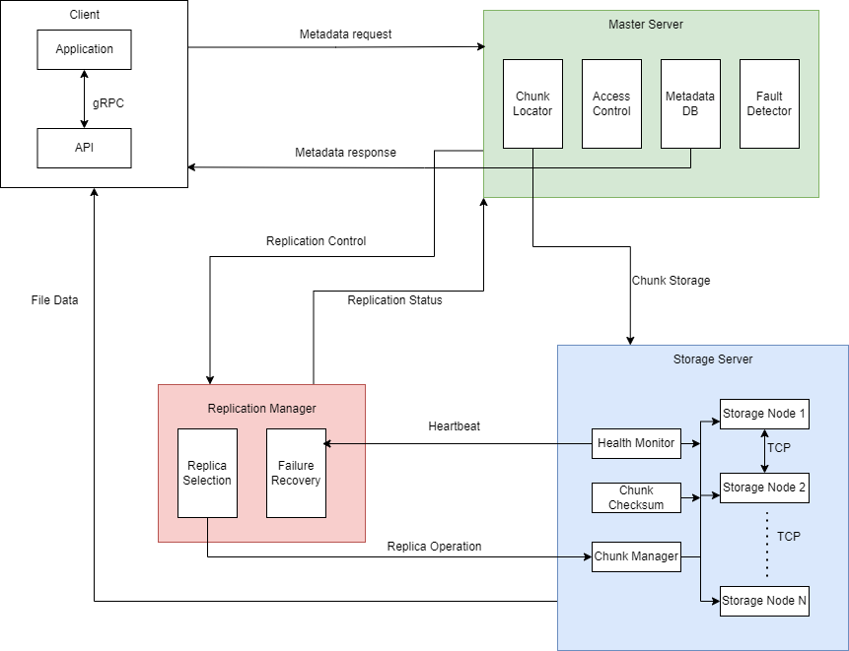

Slide 8
5. Project Progress
Finished system design, could start coding now
Still looking for advisor (experienced with cloud/distributed system)

Slide 9
6. Project Constraint
Economic
Security
Social
Environmental

Slide 10
7. Accomplishment
Finalize core components, including file partitioning, load balancing, and consistency models.
Complete implementation of fault tolerance mechanisms, such as replication and failover protocols.
Conduct extensive testing to assess system performance under different load conditions and identify bottlenecks.
Achieve a stable version of the distributed file system that supports efficient file operations across multiple nodes.

Slide 11
8. Division of Work
Currently Solo

Slide 12
9. Expected Demo
A live demonstration of file upload, retrieval, and deletion across a distributed network of nodes.
Visual representation of data replication and fault tolerance in action, showcasing the system’s response to simulated node failures.
Real-time metrics display to illustrate performance, latency, and throughput under simulated high traffic conditions.

